Slide 1

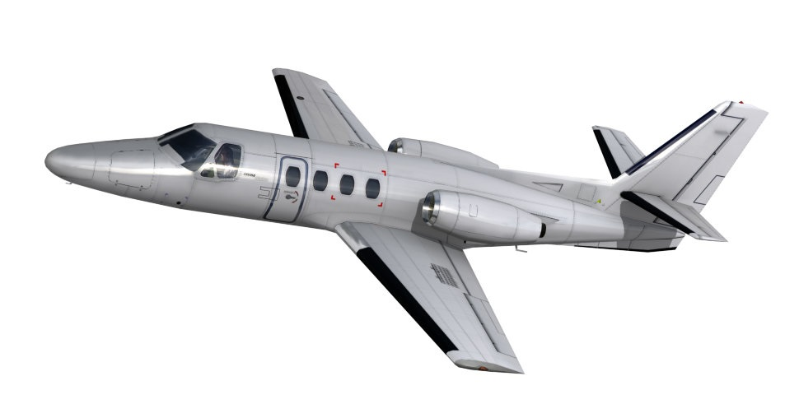
Industrial Control Project
Altitude control of Cessna Citation 500 aircraft
Project members:
Alessandro Razzoli 495714
Davide Lazzarini 489901
Gaetano Zarà 499392
Pieralberto Zucca 496484

Slide 2
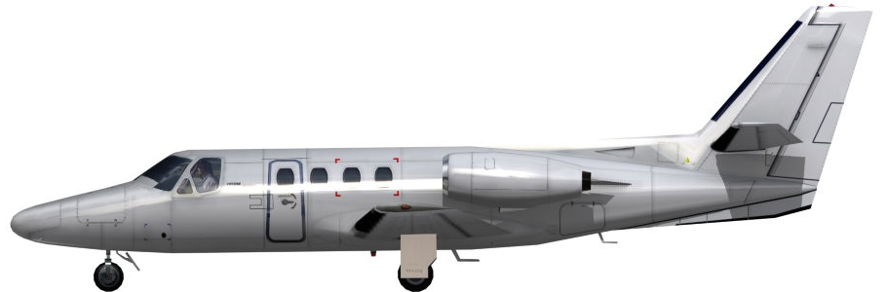
Introduction
The aim of the project is to realize a stabilizing controller for the aircraft Cessna 500.
Performance
Maximum speed: Mach 0.705
Cruise speed: 661 km/h at 11000 m
Stall speed: 152 km/h
Rate of climb: 13.81 m/s
General characteristics
Crew: Two
Capacity: 5 passengers
Length: 13.26 m
Wingspan: 14.35 m
Height: 4.37 m
Max takeoff weight: 5375 kg
Fuel capacity: 2130 L usable fuel
Powerplant: 2 × Pratt & Whitney Canada turbofans, 9.8KN

Slide 3
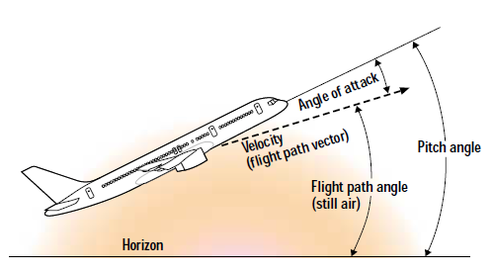
Introduction
Angles needed
1) Angle of attack: angle between the body's reference line and the oncoming flow.
2) Pitch angle: angle between the longitudinal axis (where the airplane is pointed) and the horizon.

Slide 4
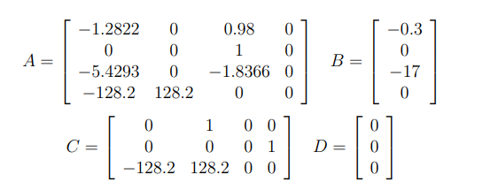
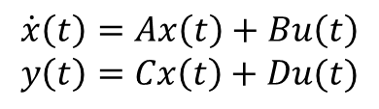
Introduction
Realization of a controller that stabilizes a Cessna Citation 500 Aircraft
Model :
$$\dot{x}\left(t\right)=Ax\left(t\right)+Bu\left(t\right)$$
$$y\left(t\right)=Cx\left(t\right)+Du(t)$$
The model is linearized at an altitude of 5000 m and a speed of 128.2 m/sec

Slide 5
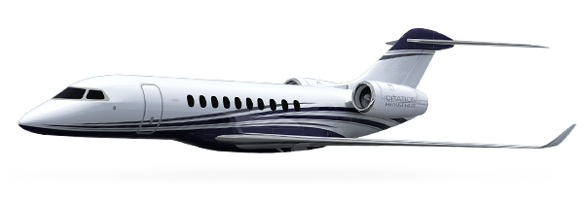
Introduction
Horizon
V
X₁
States
X₂
X₁ | The angle of attack | [rad]
X₂ | The pitch angle | [rad]
X₄
X₃ | The pitch rate | [rad/s]
X₄ | The altitude | [rad]
5000[m]
Inputs
u | the elevator angle | [rad]
For greater comfort there are constraints on x2 and u.

Slide 6
Introduction
Constraints on x2 and u :
Elevator angle (the input u corresponds to), which is limited to ±15° (±0.262 rad)
Elevator slew rate is limited to ±30°/sec (±0.524 rad/sec). These are limits imposed by the equipment design and cannot be exceeded.
Pitch angle, for the passengers' comfort, is limited to ±20° (±0.349 rad).

Slide 7
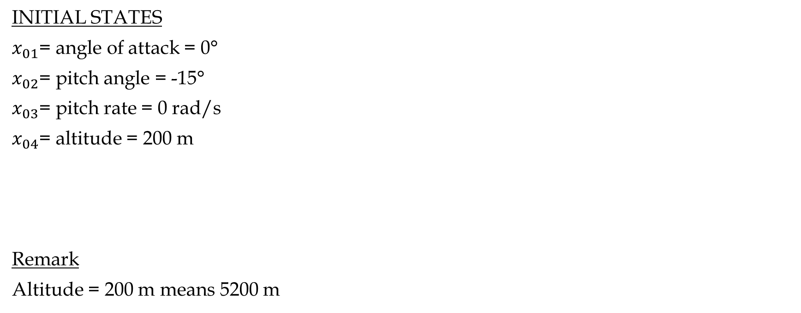
Introduction
INITIAL STATES
$x_{01}$= angle of attack = 0°
$x_{02}$= pitch angle = -15°
$x_{03}$= pitch rate = 0 rad/s
$x_{04}$= altitude = 200 m
Remark
Altitude = 200 m means 5200 m

Slide 8
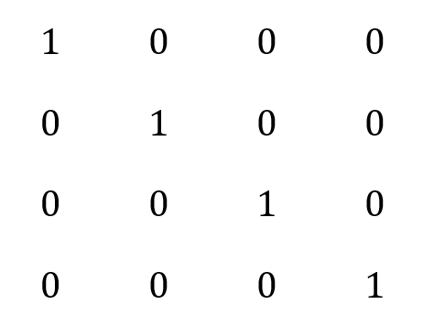
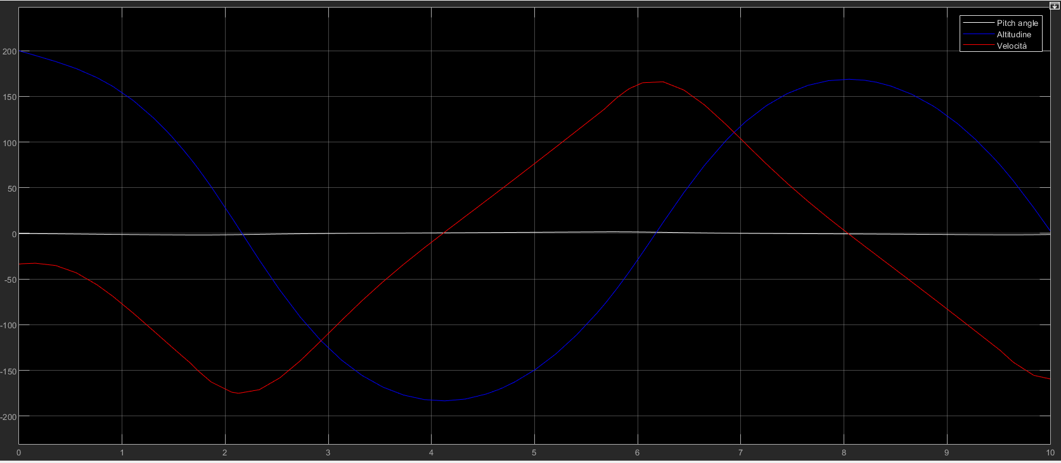
1) LQ controller: attempt 1
Pitch angle, altitude, speed
Q1 =
R1 = 1

Slide 9
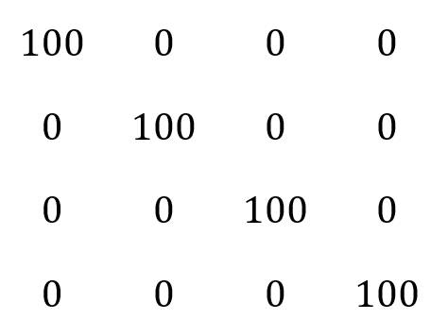
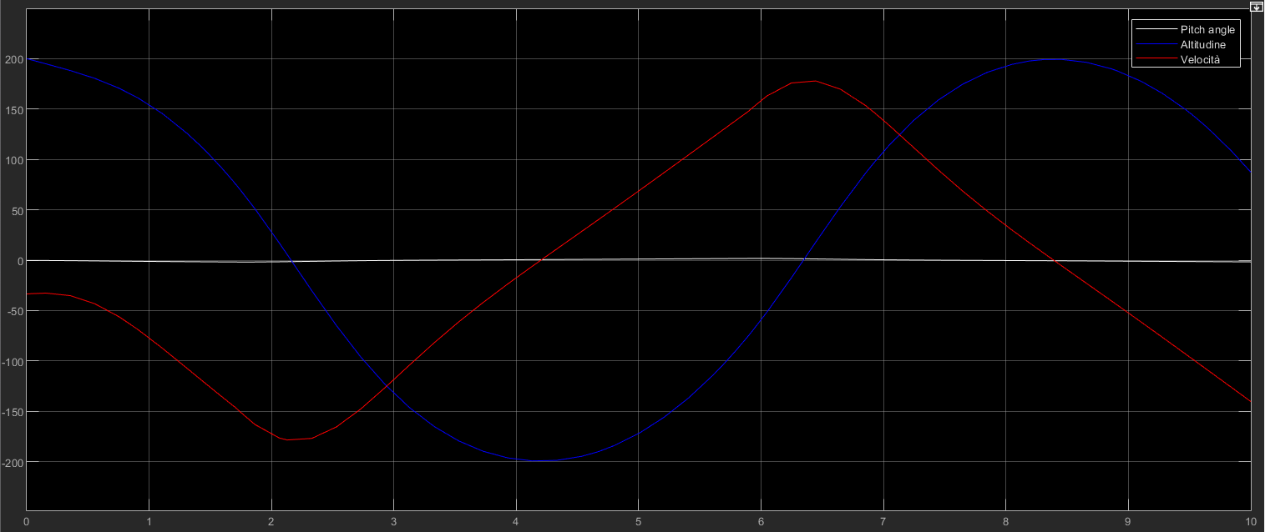
1) LQ controller: attempt 2
Pitch angle, altitude, speed
Q2 =
R2 = 1

Slide 10
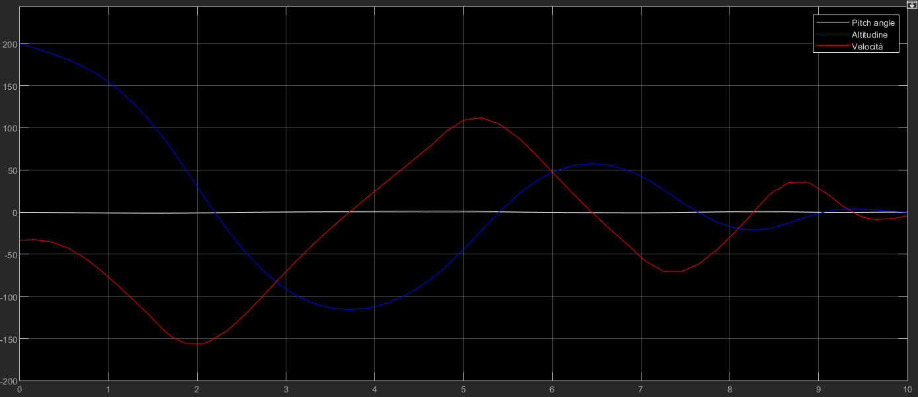
1) LQ controller: attempt 3
Pitch angle, altitude, speed
Q3 =
R3 = 100

Slide 11
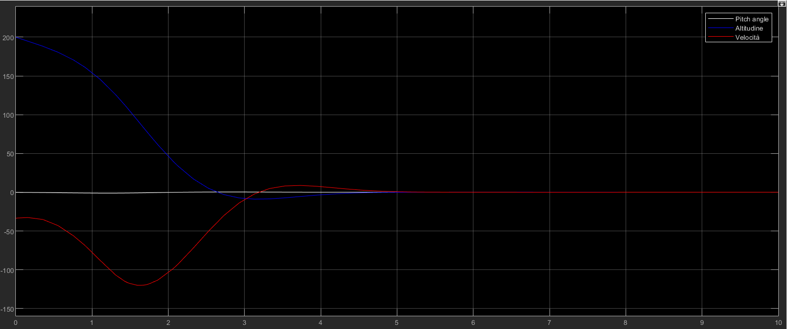
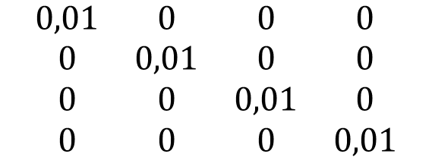
1) LQ controller: attempt 4
Pitch angle, altitude, speed
$$\begin{matrix}0,01 & 0 & 0 & 0 \\ 0 & 0,01 & 0 & 0 \\ 0 & 0 & 0,01 & 0 \\ 0 & 0 & 0 & 0,01\end{matrix}$$
Q4=
R4 = 100

Slide 12
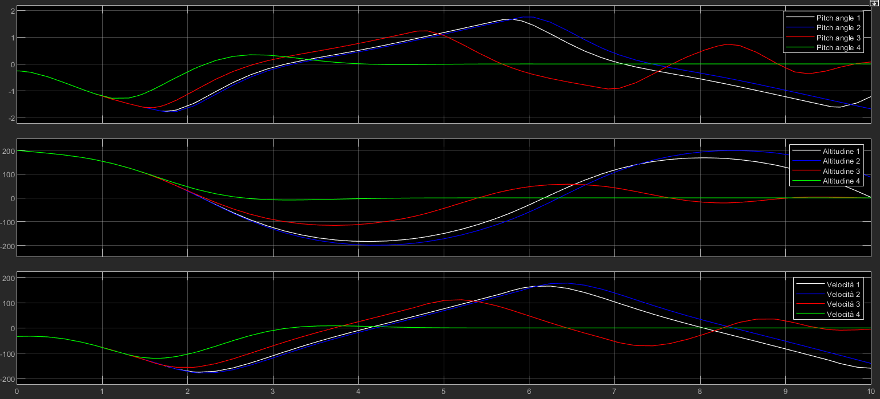
1) LQ controller: all attempt comparison

Slide 13
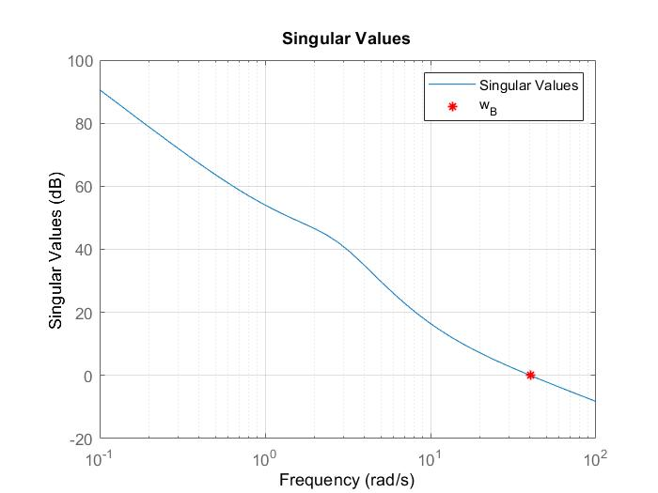

2) LQ controller discrete time
Shannon theorem:
$ω_{sample}>\text{2∗}$ $ω_{taglio}$
$\frac{2π}{T_{sample}}>$ $\text{2∗}$ $ω_{taglio}$
$$T_{sample}<\frac{π}{w_{taglio}}$$
$$ω_{taglio}=\frac{2π}{T_{taglio}}=40.15 rad/s$$
$$T_{sample}<\frac{T_{taglio}}{2}=0.078 s$$
$$T_{sample}=0.039 s$$
The sample time can’t be too low, otherwise the hardware will be very stressed and also a bigger storage memory will be needed.

Slide 14
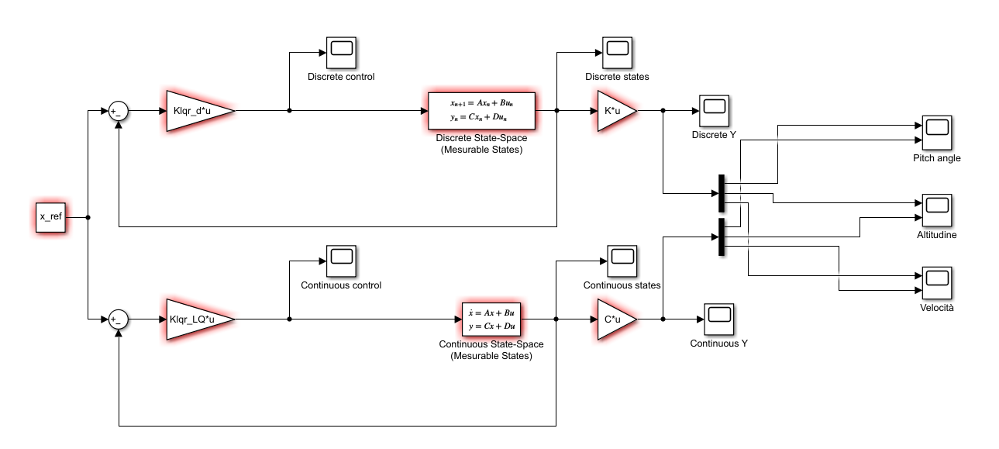
2) LQ controller discrete time
Discretized controller, simulink scheme:

Slide 15
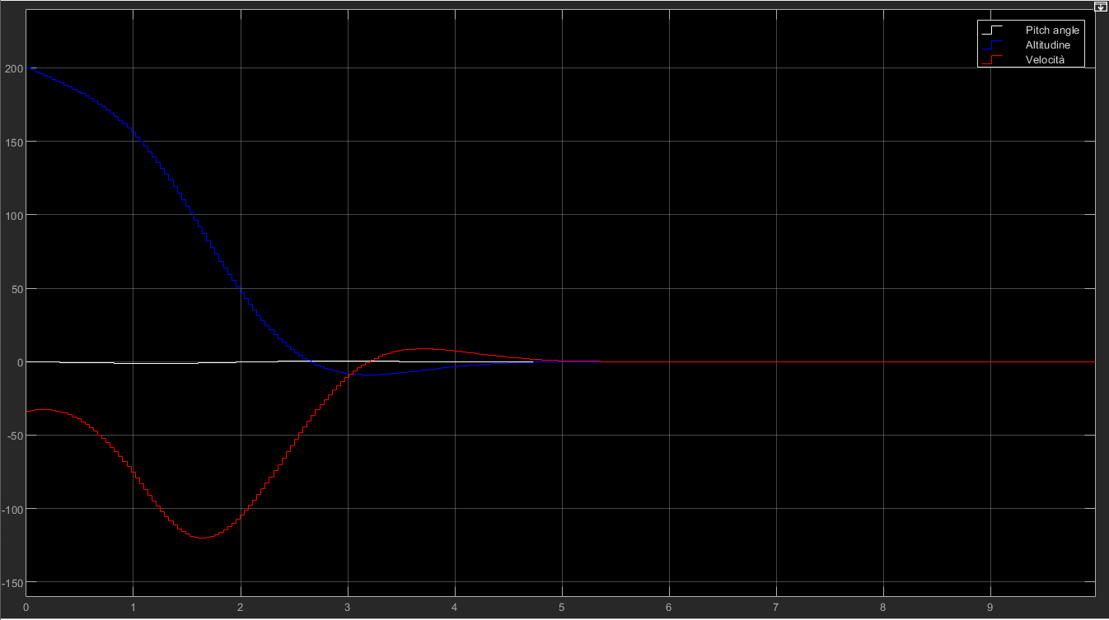
2) LQ controller discrete time
Results obtained for the discretized controller :

Slide 16
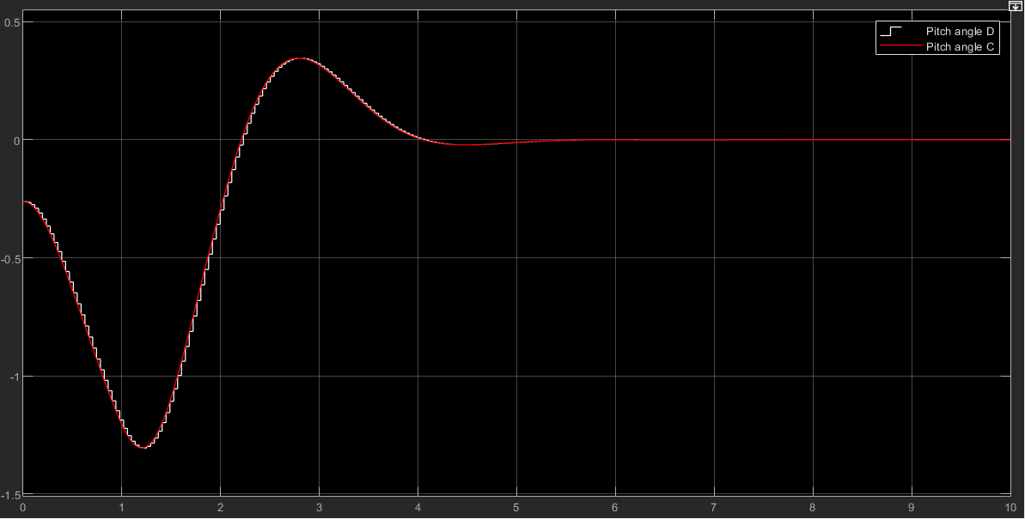
2) LQ controller discrete time
Comparison betweeen descrete and continuous time:
Pitch angle discrete – Pitch angle continuous

Slide 17
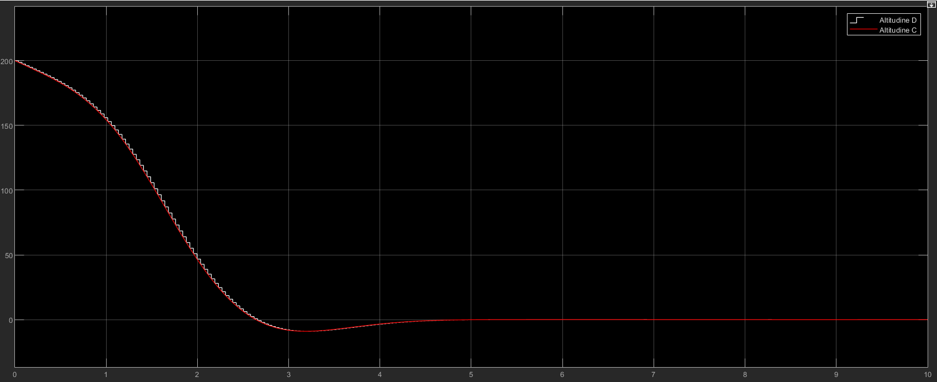
2) LQ controller discrete time
Comparison betweeen descrete and continuous time:
Altitude discrete – Altitude continuous

Slide 18
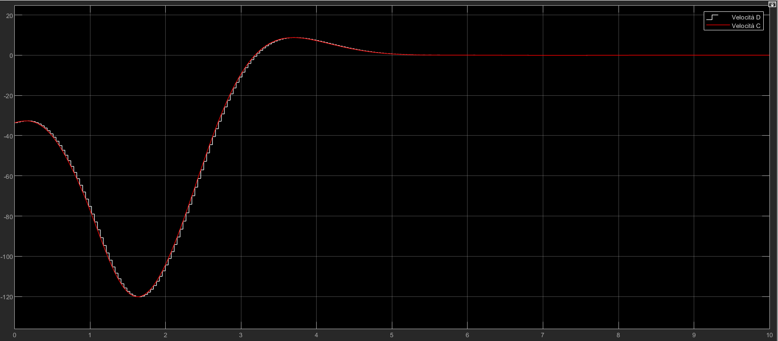
2) LQ controller discrete time
Comparison betweeen descrete and continuous time:
Speed discrete – Speed continuous

Slide 19


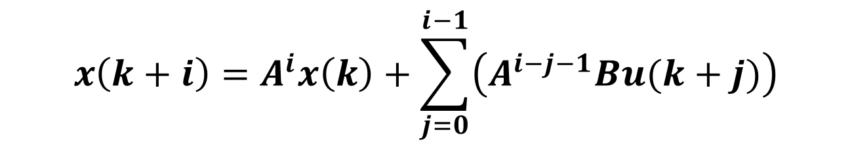
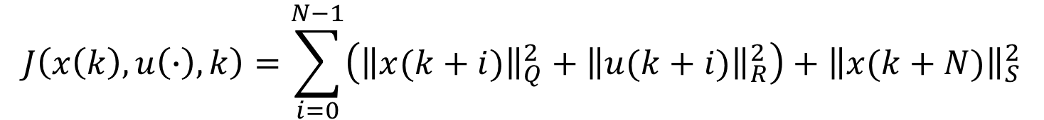

3) MPC controller discrete time
$$x(k+1)=A x\left(k\right)+B u(k)$$
Model :
$$y\left(k\right)=C x\left(k\right)$$
$$J\left(x\left(k\right), u\left(∙\right),k\right)=\sum_{i=0}^{N−1}{\left({{\left\|x(k+i)\right\|}_{Q}^{2}+\left\|u(k+i)\right\|}_{R}^{2}\right)}+{\left\|x(k+N)\right\|}_{S}^{2}$$
Cost function:
$$x\left(k+i\right)=A^{i}x\left(k\right)+\sum_{j=0}^{i−1}{\left(A^{i−j−1}Bu(k+j)\right)}$$
Open loop solution
$$X\left(k\right)=𝓐x\left(k\right)+𝓑U(k)$$

Slide 20

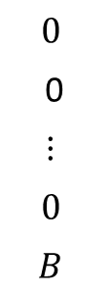


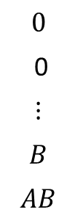
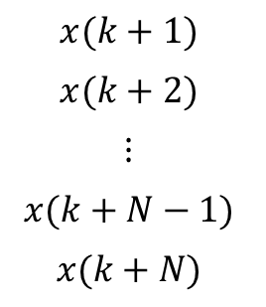
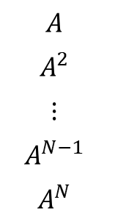



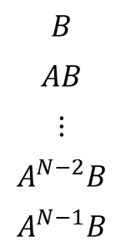
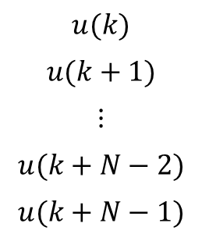
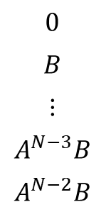

3) MPC controller discrete time
$$X\left(k\right)=𝓐x\left(k\right)+𝓑U(k)$$
$$N:orizzonte predittivo$$
$$x(k+1)$$
$$x(k+2)$$
$$⋮$$
$$x(k+N−1)$$
$$x(k+N)$$
$$A$$
$$A^{2}$$
$$⋮$$
$$A^{N−1}$$
$$A^{N}$$
$$X\left(k\right)=$$
$$𝒜=$$
$$u(k)$$
$$u(k+1)$$
$$⋮$$
$$u(k+N−2)$$
$$u(k+N−1)$$
$$B$$
$$AB$$
$$⋮$$
$$A^{N−2}B$$
$$A^{N−1}B$$
$$0$$
$$B$$
$$⋮$$
$$A^{N−3}B$$
$$A^{N−2}B$$
$$…$$
$$…$$
$$⋱$$
…
$$…$$
$$0$$
0
$$⋮$$
$$B$$
$$AB$$
$$0$$
0
$$⋮$$
$$0$$
$$B$$
$$U\left(k\right)=$$
$$ℬ=$$

Slide 21

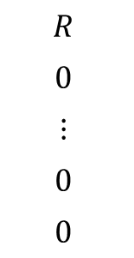
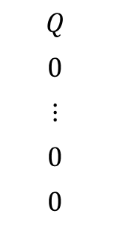
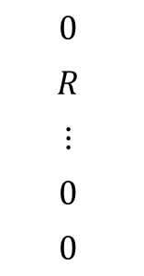
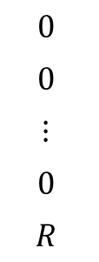
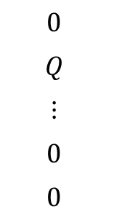


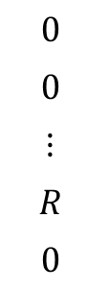
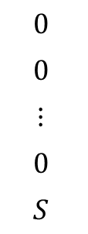
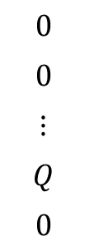

3) MPC controller discrete time
$$X\left(k\right)=𝓐x\left(k\right)+𝓑U(k)$$
$$arg\left\{\min_{u(∙)}{J\left(x\left(k\right), u\left(∙\right),k\right)}\right\}=arg\left\{\min_{U(k)}{\overline{J}\left(x\left(k\right), U\left(k\right),k\right)}\right\}$$
$$\overline{J}\left(x\left(k\right), U\left(k\right),k\right)=X^{′}\left(k\right)𝒬X\left(k\right)+U′(k)ℛU(k)$$
$$Q$$
$$0$$
$$⋮$$
$$0$$
$$0$$
$$0$$
$$Q$$
$$⋮$$
$$0$$
$$0$$
$$…$$
$$…$$
$$⋱$$
…
$$…$$
$$0$$
$$0$$
$$⋮$$
$$Q$$
$$0$$
$$0$$
$$0$$
$$⋮$$
$$0$$
$$S$$
$$R$$
$$0$$
$$⋮$$
$$0$$
$$0$$
$$0$$
$$R$$
$$⋮$$
$$0$$
$$0$$
$$…$$
$$…$$
$$⋱$$
…
$$…$$
$$0$$
$$0$$
$$⋮$$
$$R$$
$$0$$
$$0$$
$$0$$
$$⋮$$
$$0$$
$$R$$
$$𝒬=$$
$$ℛ=$$

Slide 22
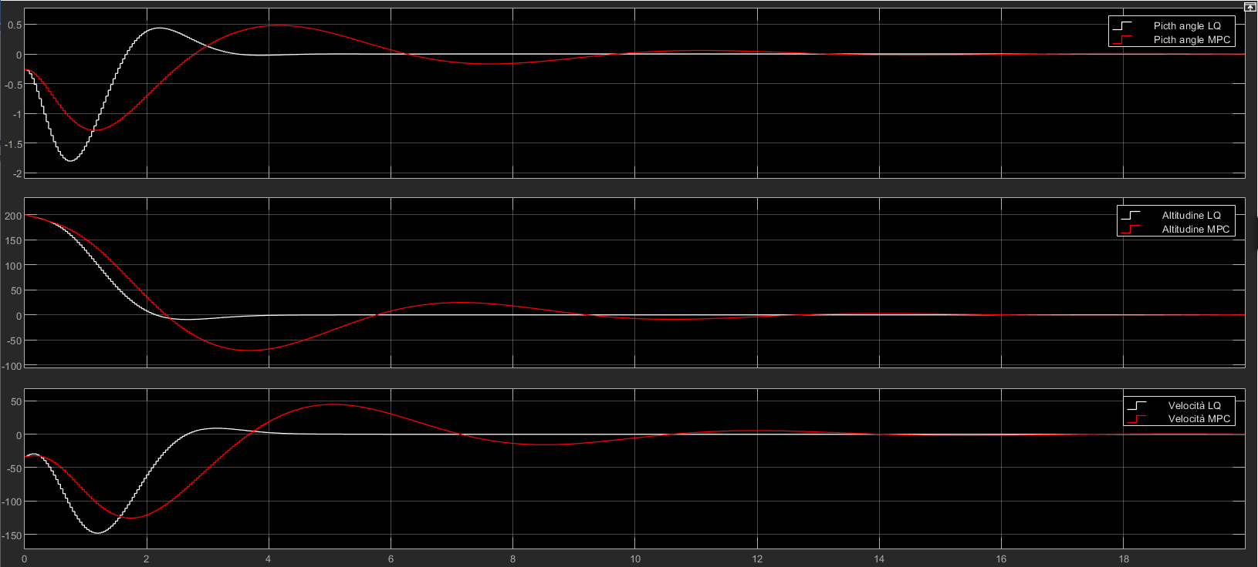
3) MPC without constraints: attempt 1
No constraints are introduced. MPC and LQ will coincide if the prediction horizon N is sufficiently long. Some attempts were done.
N=20

Slide 23
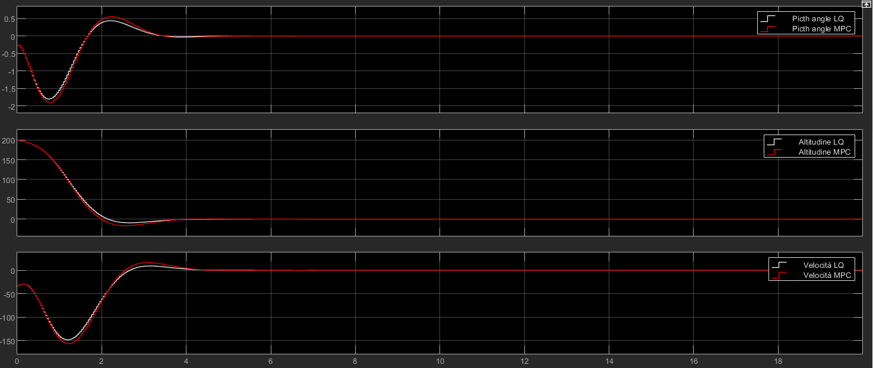
3) MPC without constraints: attempt 2
We are going in the right direction, LQ and MPC are getting closer to each other.
N=40

Slide 24
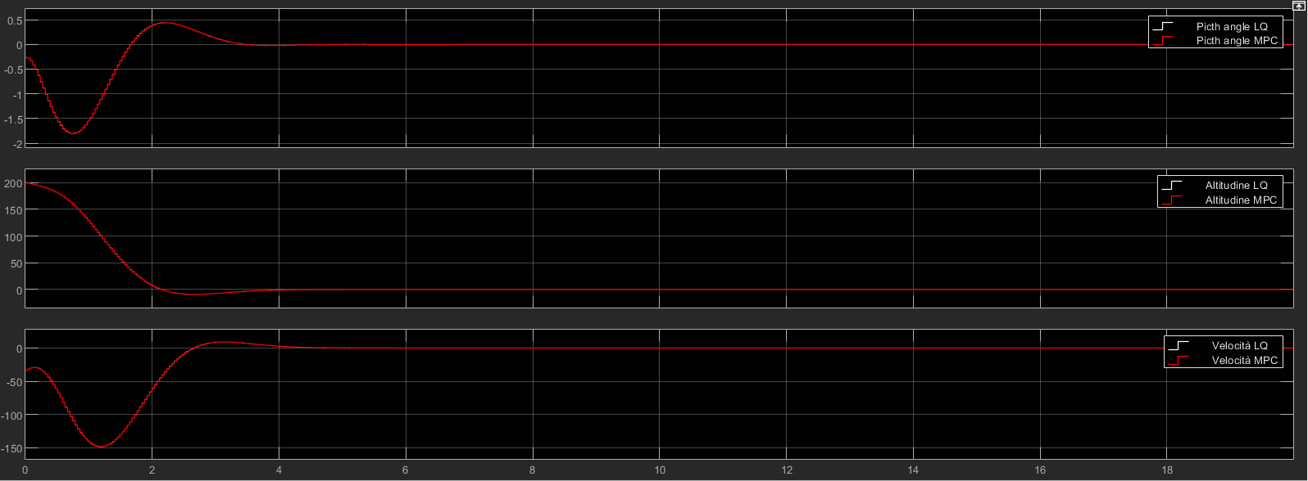
3) MPC without constraints: attempt 3
Finally, with the right choice of the horizon, they coincide.
N=80

Slide 25

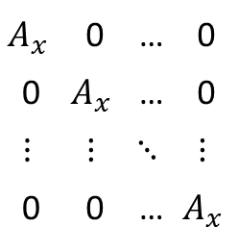









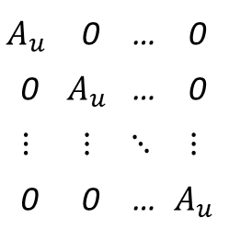


4) MPC with control constraint
Constraints are expressed in matricial form
Control constraints
States constraints
$u_{min}≤u\left(k\right)≤u_{max}$ $∀k$
$x_{min}≤x\left(k\right)≤x_{max}$ $∀k≥0$
$A_{u}u(k)≤b_{u}$ $∀k∈[0;N−1]$
$A_{x}x(k)≤b_{x}$ $∀k∈[1;N]$
$$A_{u}$$ | 0 | … | 0
0 | $$A_{u}$$ | … | 0
$$⋮$$ | $$⋮$$ | $$⋱$$ | $$⋮$$
0 | 0 | … | $$A_{u}$$
$$b_{u}$$
$$b_{u}$$
$$⋮$$
$$b_{u}$$
$$A_{x}$$ | 0 | … | 0
0 | $$A_{x}$$ | … | 0
$$⋮$$ | $$⋮$$ | $$⋱$$ | $$⋮$$
0 | 0 | … | $$A_{x}$$
$$b_{x}$$
$$b_{x}$$
$$⋮$$
$$b_{x}$$
$${\hat{b}}_{u}=$$
$${\hat{A}}_{u}=$$
$${\hat{A}}_{x}=$$
$${\hat{b}}_{x}=$$
$${\hat{A}}_{u} U(k)≤{\hat{b}}_{u}$$
$${\hat{A}}_{x} X(k)≤{\hat{b}}_{x}$$
$${\hat{A}}_{x} (𝓐x\left(k\right)+𝓑U(k))≤{\hat{b}}_{x}$$

Slide 26
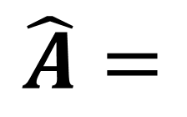

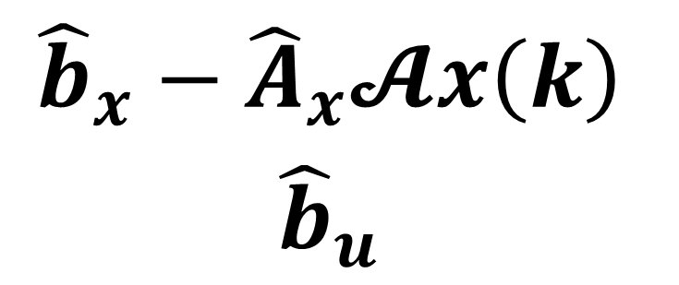

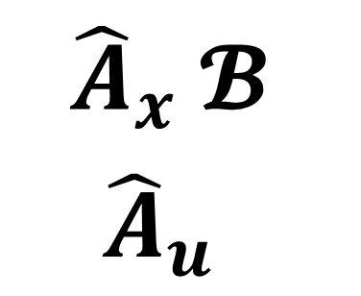

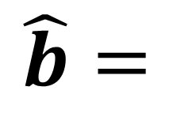
4) MPC with control constraint
Constraints are expressed in matricial form
$${\hat{A}}_{u} U(k)≤{\hat{b}}_{u}$$
$${\hat{A}}_{x} (𝓐x\left(k\right)+𝓑U(k))≤{\hat{b}}_{x}$$
$$\hat{A}U\left(k\right)≤\hat{b}$$
$${\hat{A}}_{x} 𝓑$$
$${\hat{A}}_{u}$$
$${\hat{b}}_{x}−{\hat{A}}_{x}𝓐x\left(k\right)$$
$${\hat{b}}_{u}$$
$$\hat{A}=$$
$$\hat{b}=$$

Slide 27
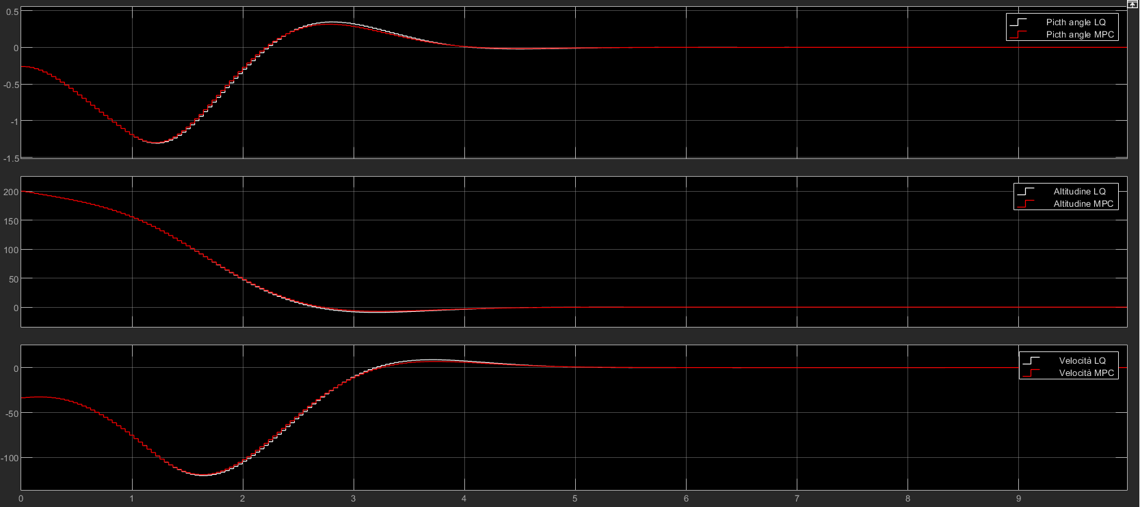
4) MPC with control constraint
In this point constraints are only on the input u.
Comparison with LQ:

Slide 28
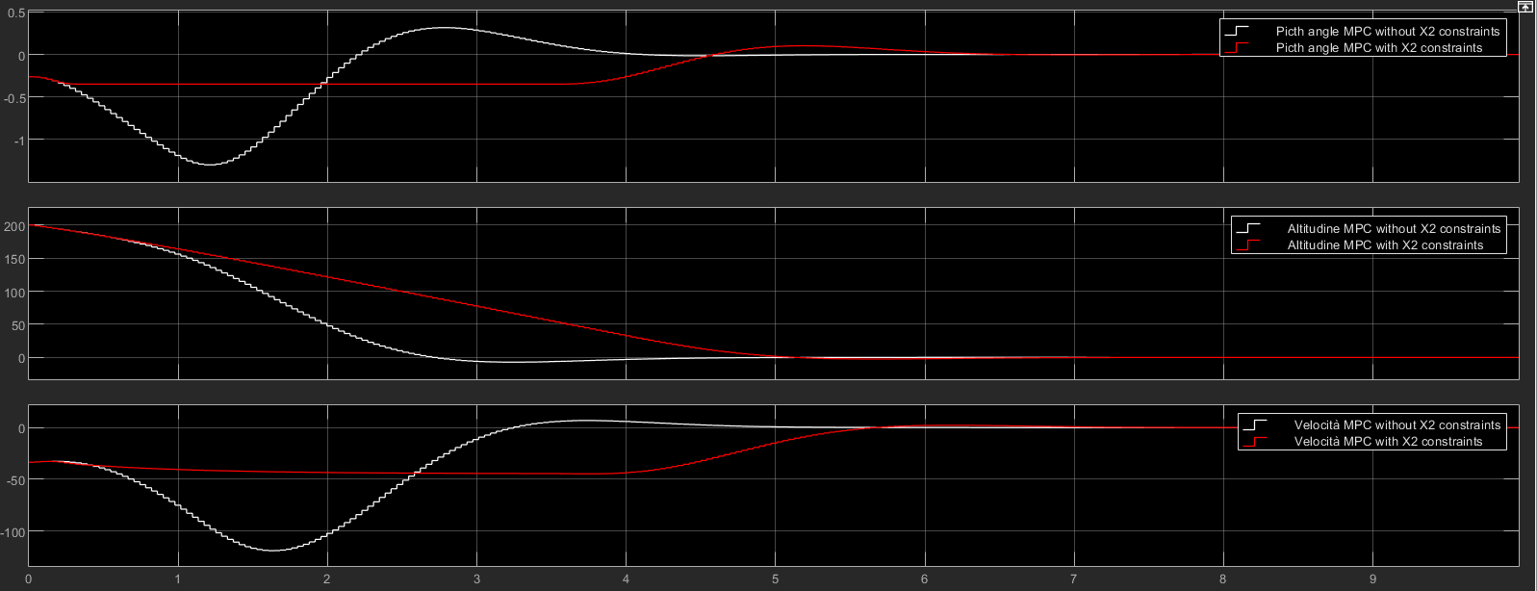

5) MPC with state x2 constraint
In this point constraints are on the state x₂(pitch angle).
-20° $≤\text{x}\text{2}≤$20°

Slide 29


6) MPC with state x4 constraint
In this point we have overshoot constraints on the state x₄(Altitude).
In addiction is maintained all the previous constraints.
$\text{x}\text{4}≤0,$200m

Slide 30


7) MPC with slew rate constraint
In this point we have slew rate constraint added to the previous ones.
-30°$≤ \text{slew} \text{rate}≤$+30°

Slide 31

7) MPC with slew rate constraint
Comparison of all the output with and without slew rate constraint :
Pitch angle, altitude, speed.

Slide 32
8) MPC with Kalman Filter
The request is to develop the MPC controller assuming that the state is not measurable,with the suggestion of using a Kalman filter

